Slide 1
TO SPECIAL
“AUTISM IS NOT DISABILITY, IT’S A DIFFERENT ABILITY”

Slide 2
GROUP MEMBERS:
MALIHA NOUSHIN RAIDA (170042001)
NAWSHIN ULFAT (170042081)
ZANNATUN NAIM SRISTY (170042043)

Slide 3
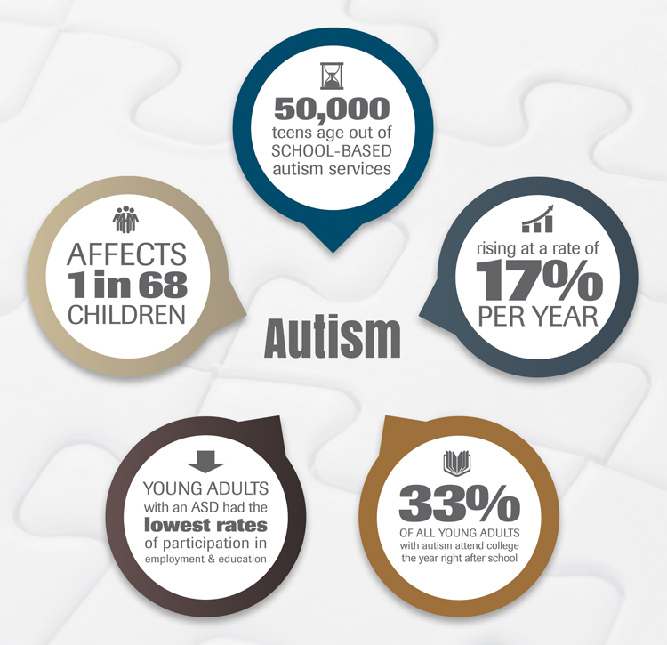
B I G
C
O
N
C
E
P
T

Slide 4
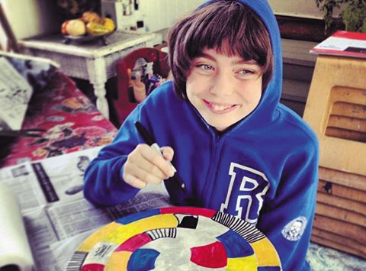
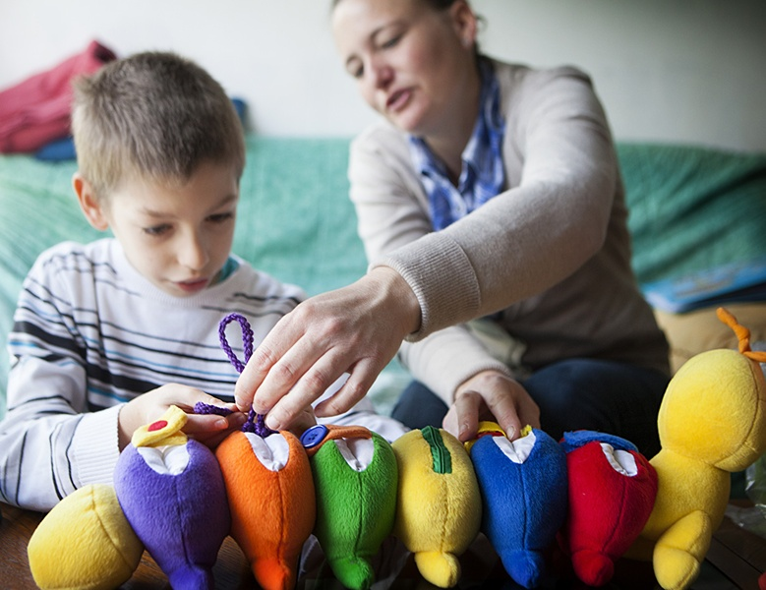
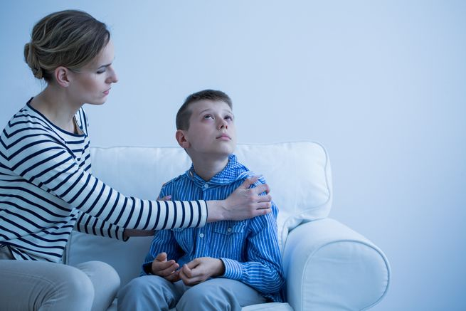
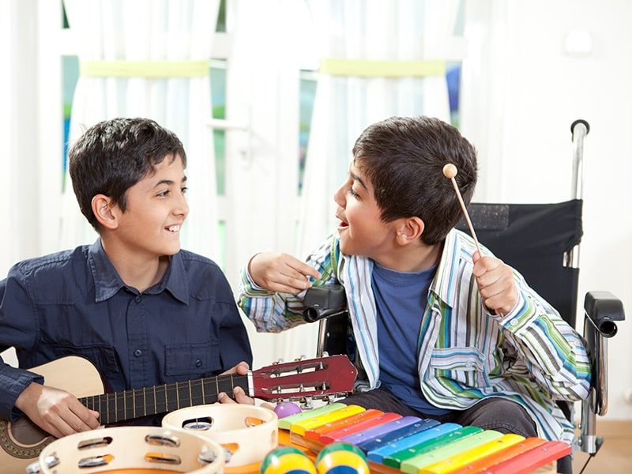
HOW DID WE START
BUT ALAS!
THE RESULT IS:
HIDDEN
TALENTS

Slide 5
A SOCIAL NETWORKING WEBSITE FOR CONNECTING THE SPECIAL CHILDREN & THOSE WHO CARE ABOUT SPECIAL CHILDREN.

Slide 6

FEATURES
CREATE
ACCOUNT
FOUR
PROFILES
POSTS
FILTER
REPORT & SAVE
POSTS
SHARE
POSTS
MESSAGE
CREATE
ACCOUNT

Slide 7
USERS
FAMILY
EDUCATOR
DOCTOR
EVERYONE

Slide 8
OUR PROCESS IS EASY
1.
UI DESIGN
(HTML,CSS)
END FEB’19
2.
MYSQL
(DATA
BASE)
END FEB’19
3. BACKEND
(JS,PHP)
AT APRIL’19
4.
APACHE
(SERVER FOR LOCAL HOST)
AT MAY’19
5.
UPDATING
& MODIFICATION

Slide 9
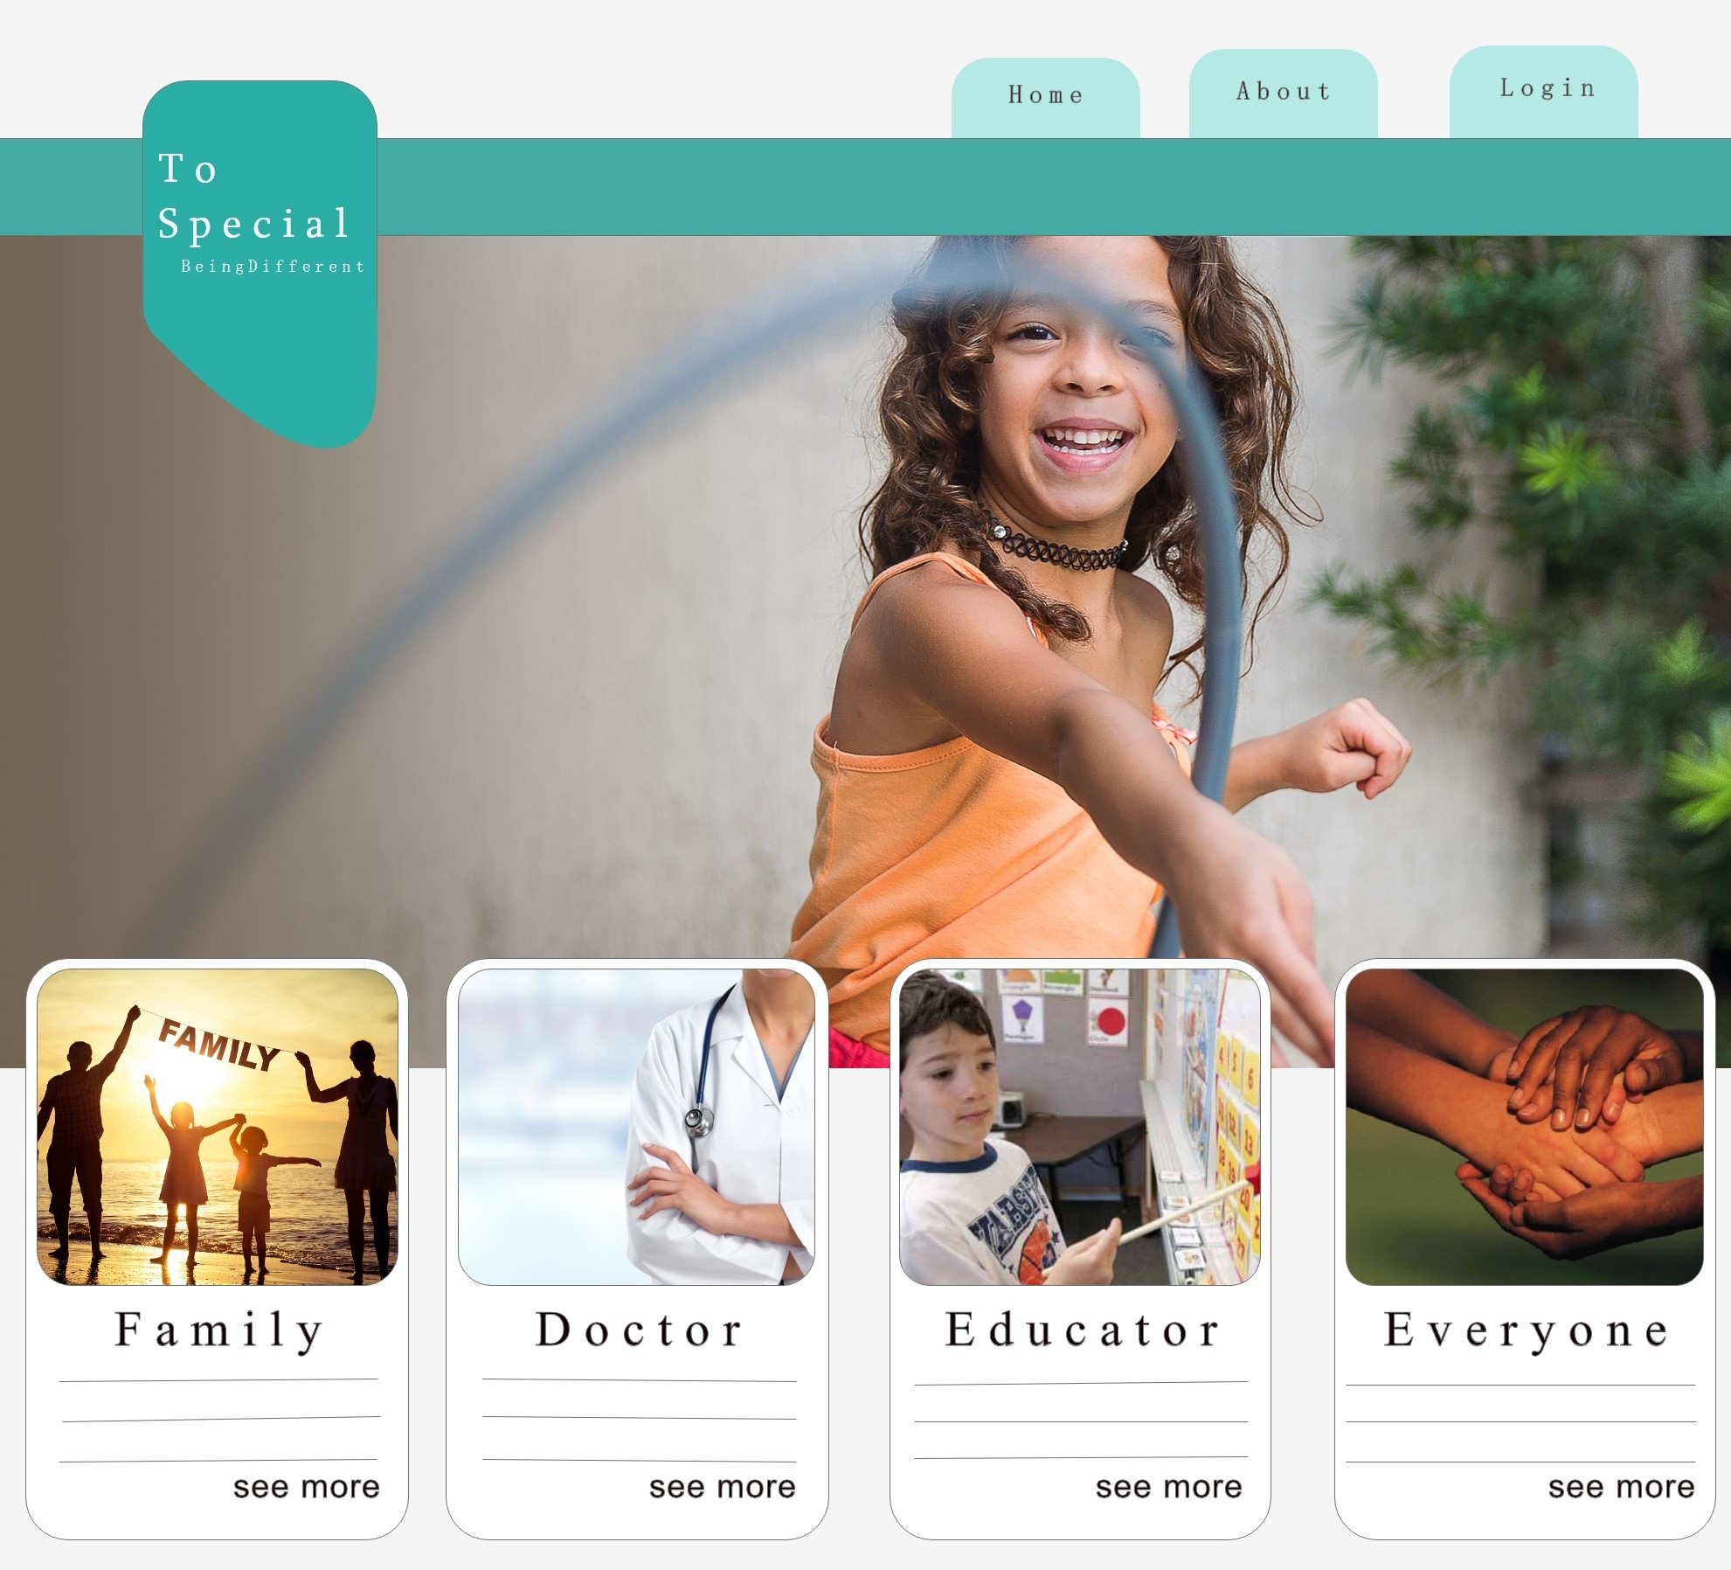
Web application

Slide 10
FUTURE GOALS
DOCTOR AND
EDUCATOR
VALIDATION
CREATE
COMMUNITIES
MOBILE
APPLICATION
CONNECT
WITH DIFFERENT
ORGANIZATIONS

Slide 11
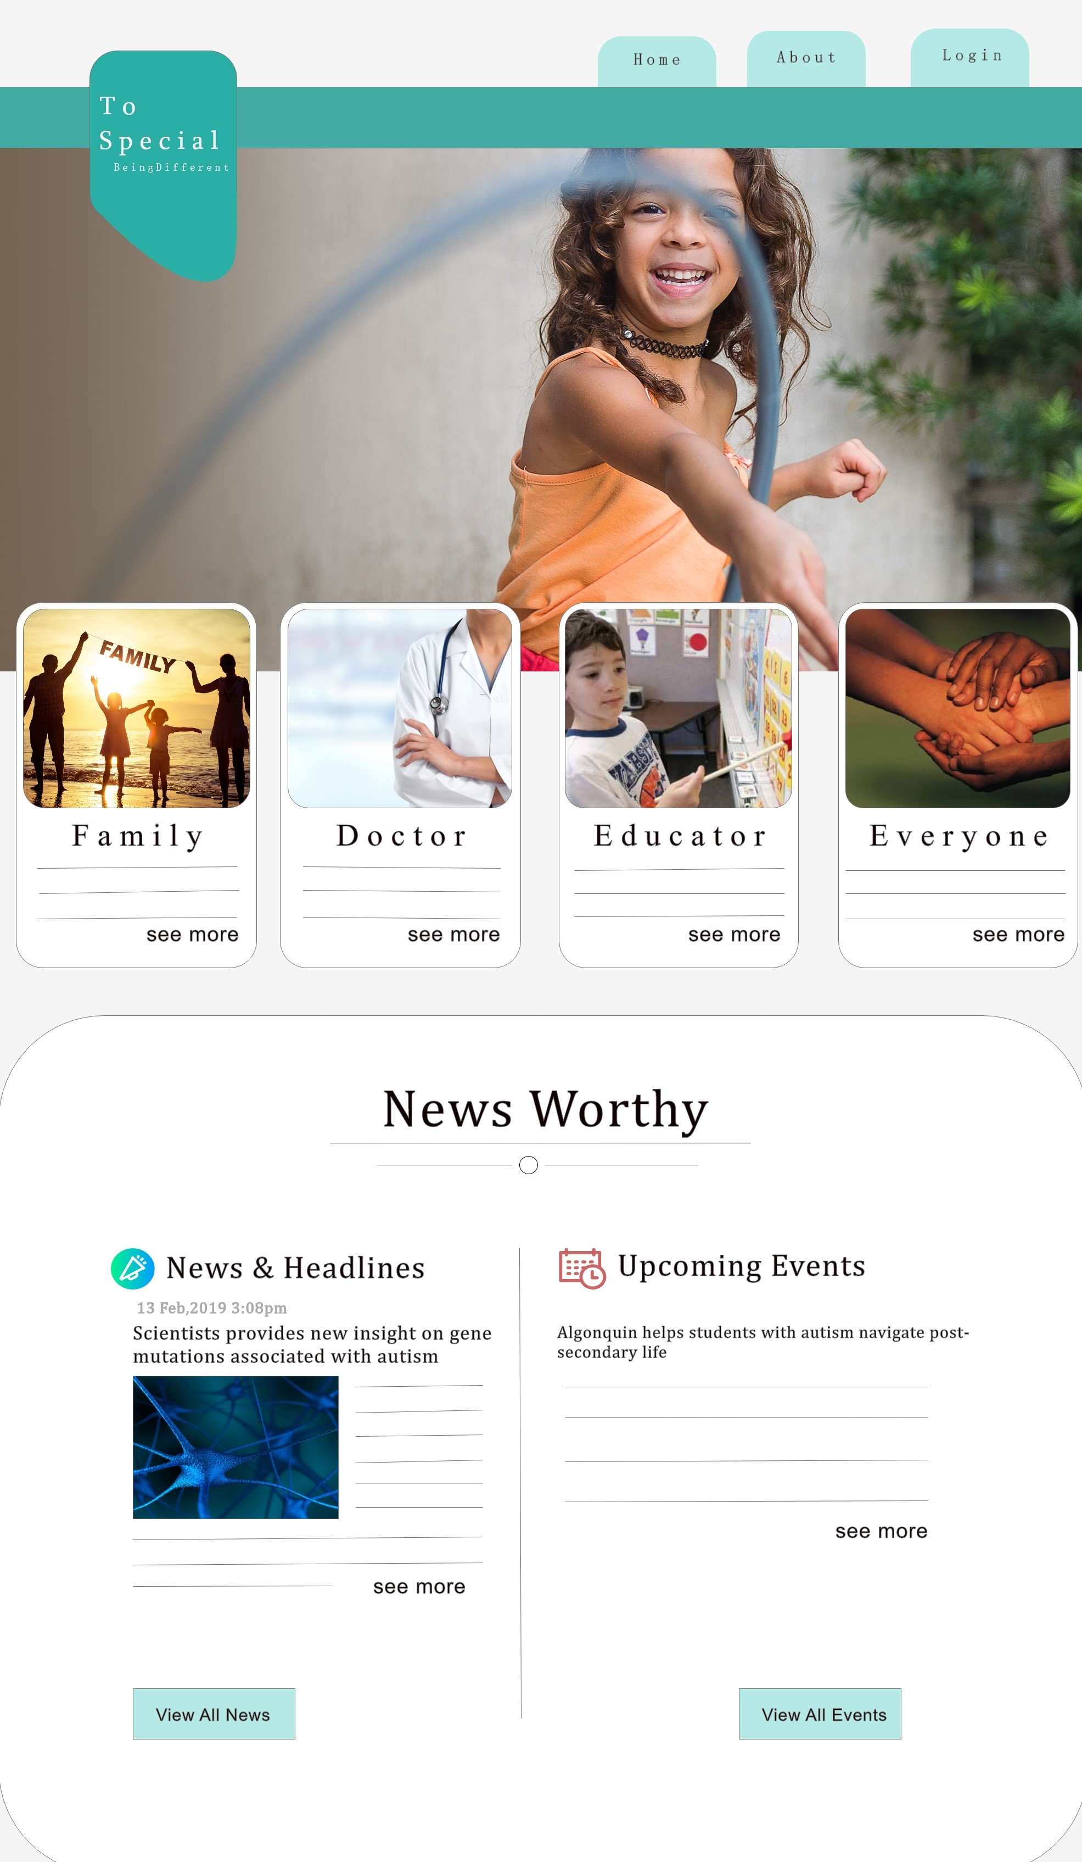
FUTURE
Android version Of Web Application

Slide 12
Thanks!
Any questions?

